Slide 1
SQL
Database Commands in MySql
Creating Table with Constraints
The following constraints are commonly used in SQL:
NOT NULL -It Ensures that a column cannot have a NULL value UNIQUE - It Ensures that all values in a column are different PRIMARY KEY - A combination of a NOT NULL and UNIQUE. Uniquely identifies each row in a table
FOREIGN KEY - It Uniquely identifies a row/record in another table CHECK - It Ensures that all values in a column satisfies a specific condition
DEFAULT - It Sets a default value for a column when no value is specified INDEX - It is Used to create and retrieve data from the database very quickly

Slide 2
SQL
Database Commands in MySql
Creating Table with Constraints
MySQL> CREATE TABLE Persons (
ID INT NOT NULL PRIMARY KEY,
LastName VARCHAR(255) NOT NULL,
FirstName VARCHAR(255),
Age INT CHECK (Age>=18),
City VARCHAR(255) DEFAULT ‘Jaipur');
MySQL> CREATE TABLE Orders (
OrderID int NOT NULL PRIMARY KEY,
OrderNumber int NOT NULL,
PersonID int,
FOREIGN KEY (PersonID) REFERENCES Persons(ID) );

Slide 3
SQL
Database Commands in MySql
Altering Table
The SQL ALTER TABLE command is used to add, delete or modify columns in an existing table. You should also use the ALTER TABLE command to add and drop various constraints on an existing table.
Syntax
The basic syntax of an ALTER TABLE command to add a New Column in an existing table is as follows:
ALTER TABLE table_name ADD column_name datatype;
The basic syntax of an ALTER TABLE command to DROP COLUMN in an
existing table is as follows.
ALTER TABLE table_name DROP COLUMN column_name;
The basic syntax of an ALTER TABLE command to change the DATA TYPE
of a column in a table is as follows.
ALTER TABLE table_name MODIFY COLUMN column_name datatype;

Slide 4
SQL
Database Commands in MySql
Altering Table
The basic syntax of an ALTER TABLE command to add a NOT NULL constraint to a column in a table
is as follows.
ALTER TABLE table_name MODIFY column_name datatype NOT NULL;
The basic syntax of ALTER TABLE to ADD UNIQUE CONSTRAINT to a table is as follows. ALTER TABLE table_name
ADD CONSTRAINT MyUniqueConstraint UNIQUE(column1, column2...);
The basic syntax of an ALTER TABLE command to ADD CHECK CONSTRAINT to a table is as follows.
ALTER TABLE table_name
ADD CONSTRAINT MyUniqueConstraint CHECK (CONDITION);
The basic syntax of an ALTER TABLE command to ADD PRIMARY KEY constraint to a table is as follows.
ALTER TABLE table_name
ADD CONSTRAINT MyPrimaryKey PRIMARY KEY (column1, column2...);
The basic syntax of an ALTER TABLE command to DROP CONSTRAINT from a table is as follows.
ALTER TABLE table_name
DROP CONSTRAINT MyUniqueConstraint;

Slide 5
SQL
MySQL Order By clause is used to sort the table data in either Ascending order or Descending order. By default, data is not inserted into Tables in any order unless we have an index.
So, If we want to retrieve the data in any particular order, we have to sort it by using MySQL Order By statement.
Syntax:-SELECT Column_Names FROM Table_Name
ORDER BY {Column1}[ASC | DESC] {Column2}[ASC | DESC]

Slide 6
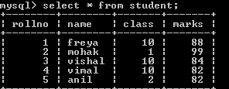
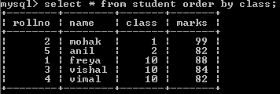
SQL
MySQL Order by– e.g.
Suppose we are having student table with following data.
Now we write the query – select * from student order by class;
Query result will be in ascending order of class.If we not specify asc/desc in
query then ascending clause is applied by default

Slide 7
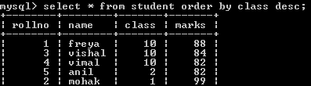
SQL
MySQL Order by– e.g.
Suppose we are having student table with following data.
Now we write the query – select * from student order by class desc;
Query result will be in descending order of class

Slide 8
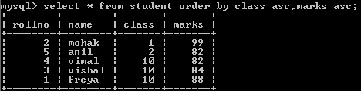
SQL
MySQL Order by – e.g.
Suppose we are having student table with following data.
Now we write query–select * from student order by class asc, marks asc;
Query result will be ascending order of class and if same class exists then ordering will done on marks column(ascending order)

Slide 9
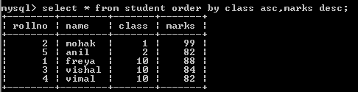
SQL
MySQL Order by– e.g.
Suppose we are having student table with following data.
Now we write query–select * from student order by class asc, marks desc;
Query result will be ascending order of class and if same class exists then ordering will done on marks column(descending order)

Slide 10
SQL
An aggregate function performs a calculation on multiple values and returns a single value. For example, you can use the AVG() aggregate function that takes multiple numbers and returns the average value of the numbers.Following is the list of aggregate functions supported by MySQL.
Name | Purpose
SUM() | Returns the sum of given column.
MIN() | Returns the minimum value in the given column.
MAX() | Returns the maximum value in the given column.
AVG() | Returns the Average value of the given column.
COUNT() | Returns the total number of values/ records as per given column.

Slide 11
SQL
Aggregate Functions & NULL
Consider a table Emp having following records as-
Null values are excluded while (avg)aggregate function is used
Emp
Code | Name | Sal
E1 | Mohak | NULL
E2 | Anuj | 4500
E3 | Vijay | NULL
E4 | Vishal | 3500
E5 | Anil | 4000
SQL Queries
Result of query 12000
3500
4500
3
4000
5
MySQL> Select Sum(Sal) from EMP; MySQL> Select Min(Sal) from EMP; MySQL> Select Max(Sal) from EMP; MySQL> Select Count(Sal) from EMP; MySQL> Select Avg(Sal) from EMP;
MySQL> Select Count(*) from EMP;

Slide 12
SQL
The GROUP BY clause groups a set of rows/records into a set of summary rows/records by values of columns or expressions. It returns one row for each group.
We often use the GROUP BY clause with aggregate functions such as SUM, AVG, MAX, MIN, and COUNT. The aggregate function that appears in the SELECT clause provides information about each group.
The GROUP BY clause is an optional clause of the SELECT statement.
Syntax –
SELECT 1, c2,..., cn, aggregate_function(ci)
FROM table WHERE where_conditions GROUP BY c1 , c2,...,cn; Here c1,c2,ci,cn are column name

Slide 13

SQL
MySQL group by – e.g.
Suppose we are having student table with following data.
Now we write query–select class from student group by class;
Query result will be unique occurrences of class values,just similar to use distinct clause like(select distinct class from student).

Slide 14

SQL
MySQL GROUP BY with aggregate functions
The aggregate functions allow us to perform the calculation of a set of rows and return a single value. The GROUP BY clause is often used with an aggregate function to perform calculation and return a single value for each subgroup.
For example, if we want to know the number of student in each class, you can use the COUNT function with the GROUP BY clause as follows:Suppose we are having student table with following data.
Now we write query–select class,count(*) from student group by class;
Query result will be unique occurrences of class values along with counting of students(records) of each class(sub group).

Slide 15

SQL
MySQL GROUP BY with aggregate functions
we are having student table with following data.
Now we write query–select class,avg(marks) from student group by class;
Query result will be unique occurrences of class values along with average
marks of each class(sub group).

Slide 16

SQL
MySQL GROUP BY with aggregate functions (with where and order by clause)
we are having student table with following data.
Now we write query–select class,avg(marks) from student where class<10 group by class order by marks desc;
Query result will be unique occurrences of class values where class<10 along with average marks of each class(sub group) and descending ofer of marks.

Slide 17
SQL
The HAVING clause is used in the SELECT statement to specify filter conditions for a group of rows or aggregates. The HAVING
clause is often used with the GROUP BY clause to filter groups based on a specified condition. To filter the groups returned by GROUP BY clause, we use a HAVING clause.
WHERE is applied before GROUP BY, HAVING is applied after (and can filter on aggregates).

Slide 18

SQL
MySQL GROUP BY with aggregate functions & having clause
we are having student table with following data.
Now we write query–select class,avg(marks) from student group by class having avg(marks)<90;
Query result will be unique occurrences of class values along with average
marks of each class(sub group) and each class having average marks<90.

Slide 19

SQL
MySQL GROUP BY with aggregate functions & having clause
we are having student table with following data.
Now we write query–select class,avg(marks) from student group by class having count(*)<3;
Query result will be unique occurrences of class values along with average
marks of each class(sub group) and each class having less than 3 rows.

Slide 20

 |  | SQL
Cartesian product (X)/cross joint
Cartesian Product is denoted by | X | symbol.
Lets say we have two relations | R1 | and R2
then the cartesian product of these two relations (R1 X R2) would combine each tuple of first relation R1 with the each tuple of second relation R2.

Slide 21
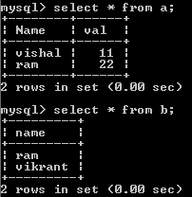
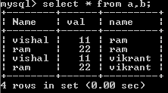
SQL
Cartesian product (X) example
Table a and Table b as shown below
Mysql query –
Select * from a,b;
Select * from a cross join b;
Degree of cartesion product is 3 and cardinality is 4=(2 rows of a X 2 rows of b)

Slide 22
SQL
Join – Join is used to fetch data from two or more tables, which is joined to appear as single set of data. It is used for combining column from two or more tables by using values common to both tables.
Types of JOIN
Following are the types of JOIN that we can use in SQL:
Inner
Outer
Left
Right

Slide 23
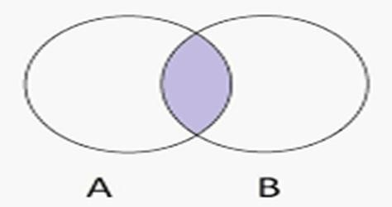
INNER Join or EQUI Join⋈
This is a simple JOIN in which the result is based on matched data as per the equality condition specified in the SQL query.
SQL

Slide 24


SQL
INNER Join or EQUI Join example Table a and Table b as shown below
Mysql query –
Select course.student_name from couse , student where course.student_name=student.stude nt_name;
Select a.name from a inner join b where a.name=b.name;

Slide 25

SQL
Natural JOIN(⋈)
Natural Join is a type of Inner join which is based on column having same name and same datatype present in both the tables to be joined.E.g.
Select * from a natural join b;

Slide 26
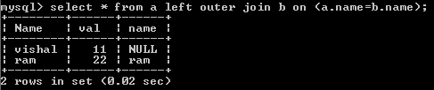
SQL
LEFT Outer Join
The left outer join returns a resultset table with the matched data from the two tables and then the remaining rows of the left table and null from the
right table's columns. E.g.
Mysql query –
Select * from a left outer join b on (a.name=b.name);

Slide 27
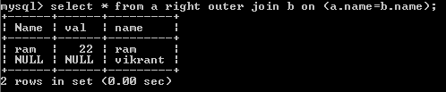
SQL
RIGHT Outer Join
The right outer join returns a resultset table with the matched data from the two tables being joined, then the remaining rows of the right table and null for the remaining left table's columns.E.g.
Mysql query –
Select * from a right outer join b on (a.name=b.name);

Slide 28
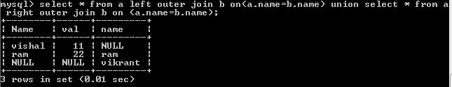
SQL
Full Outer Join
The full outer join returns a resultset table with the matched data of two table then remaining rows of both left table and then the right table.E.g.
Mysql query –
Select * from a left outer join b on (a.name=b.name) union Select * from a right outer join b on (a.name=b.name) ;

